Slide 1

Recognizing Emotion from Images Project 3
Team 5: Ziqin Zhao| Marko Konte | Tianning Yu | Jiawei Liu (Presenter) | Shenghan Chen

Slide 2
Methods Used
Baseline: Gradient Boosting Model (Claimed test accuracy: 38%)
Best Advanced Model: Neural Network (Claimed test accuracy: 54%)
Other Methods used:
Ensemble (2nd best)
XGBoost
SVM
LDA
Logistic Regression
Random Forest

Slide 3
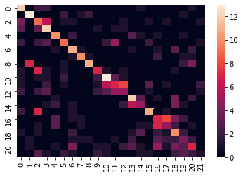
Baseline: Gradient Boosting
Gradient Boosting Models is a powerful approach which learns on repeated iterations using the most significant predictive features from data.
GBM parameters:
n_estimators = 100
Max_depth= 1
learning_rate=0.1
Performance result:
Accuracy: 38.20%
Time for fitting: 8.6 Minutes
Time for prediction: 0.036s
Confusion Matrix:

Slide 4
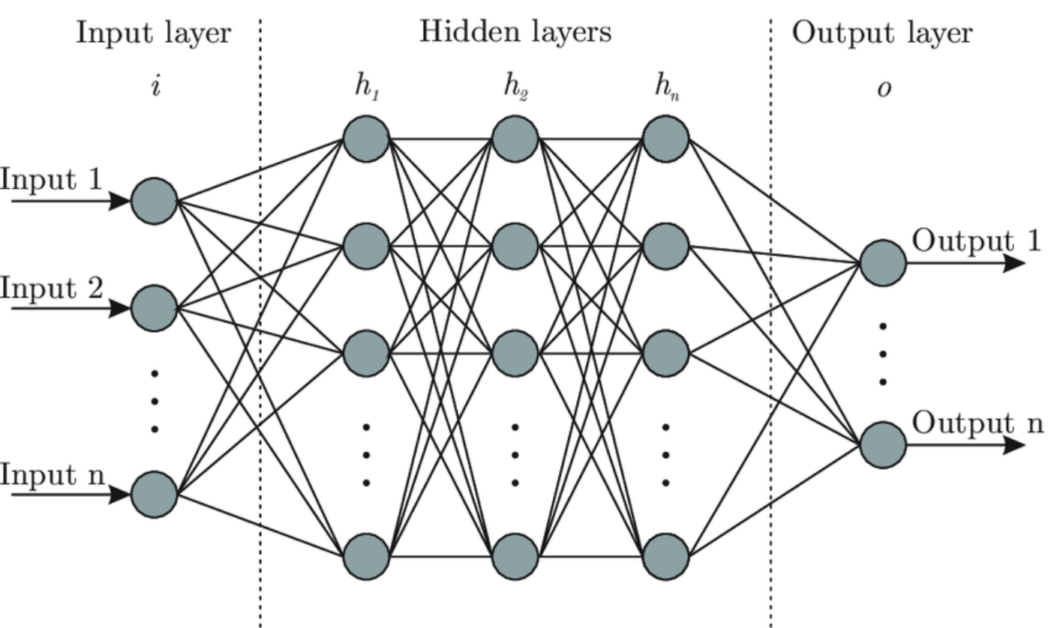
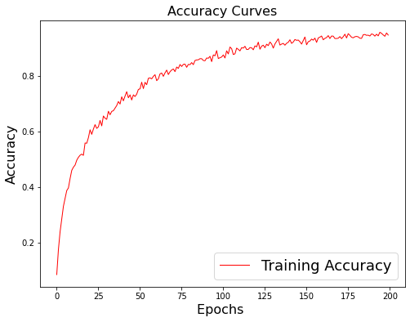
Best Advanced Model: Neural Network
Convolutional Neural Net models take a collection of inputs and improves accuracy by building on significant features validated through thresholds calculated within the hidden layer. This ultimately creates a predictor for the classifier within the output layer- image representation:
CNN Parameters used:
- Activation input: Rectified linear Unit (element wise non linear)
- Activation output: Softmax (normalized, winner take all)
- Epochs = 200
Performance Result:
Test Accuracy: 53.86%
Time for fitting model: 11.24 minutes
Time for prediction: 0.9s

Slide 5
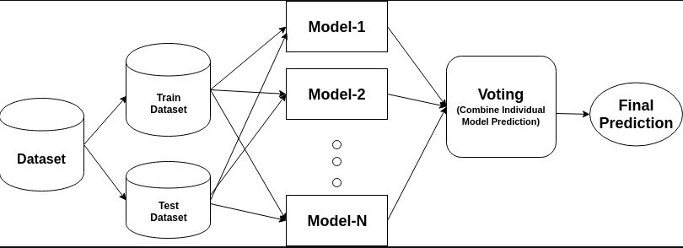
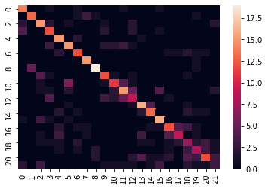
Second Best Advanced Model: Ensemble
This type of model allows for combining multiple model results to improve the end classification. In our model we used the Voting method for the ensemble model to make the final combination using Logistic Regression, LDA, and SVM Methods.
Models used:
Linear Discriminant Analysis (LDA)
Logistic Regression
Support Vector Machine (SVM)
Performance Results:
Test accuracy: 53.48
Model fitting time: 3.07 minutes
Model prediction: 6.7s
Confusion Matrix Ensemble:

Slide 6
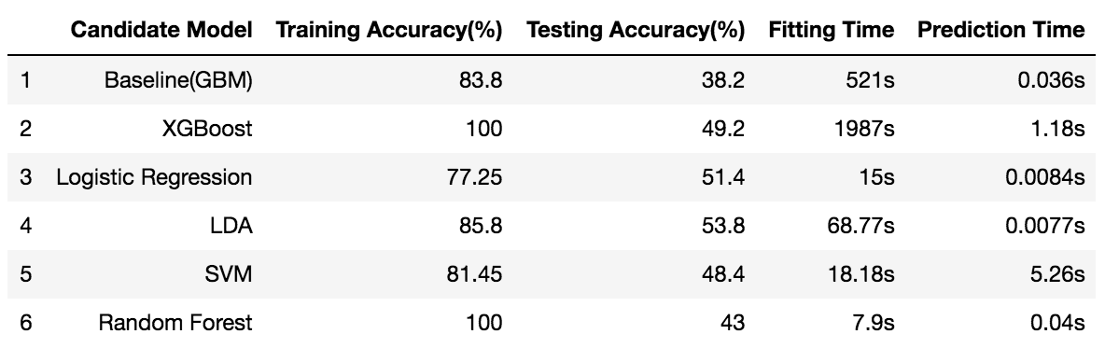
Additionally tested Advanced Models
SVM
Test Accuracy: 48.4%
Model Fitting time: 18.2s
Model Prediction: 5.26s
LDA
Test accuracy: 53.8%
Model time: 1.15 minutes
XGBoost
Test accuracy: 49.2%
Model Fitting time: 33 minutes
Model Prediction: 1.18s
Logistic Regression
Test accuracy: 51.4%
Model Fitting time: 15 s
Model Prediction: 0.0084s
Random forest
Test accuracy: 43.0%
Model Fitting Time: 7.9 seconds
Model Prediction: 0.04s
Comparison Matrix

Slide 7
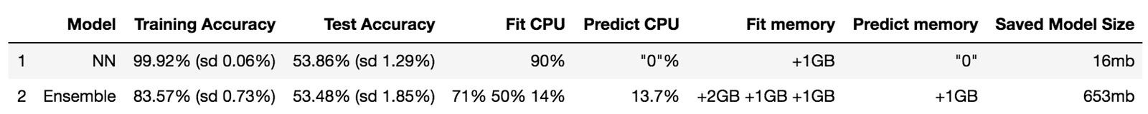
Comparing Best Performing Advanced Models
Why Neural Network and Ensemble:
Predicting a classification with so many features as a facial expression has requires a model that will reduce those dimensions while iterating on itself to pick the most significant variables. These two model types provide this in differing ways. NN’s through iterating significant features in a network, and Ensemble by running multiple model types and combining for the best result.
Ultimately, Neural Network was chosen as it had slightly better accuracy with lower deviation in its result on a consistent basis, although there were iterations where Ensemble performed better. While Ensemble generally took less time, both models performed at acceptable time frames.

